Slide 1
Research Platform for Custom Memory Cube
Yu Zou
Vinayak Deshpande
Peter Harduvel
Dr. Herman Lam
Assoc. Professor of ECE
University of Florida

Slide 2
Outline
Review & overview
Notional CMC architecture
Performance measurements on Merlin board
Mapping notional CMC to Merlin board
Experiments & measurements
Non-overlapping memory access
Simple read & write ops, DRE ops
Overlapping memory access
Simple read & write ops, DRE ops
Simplified CMC-to-Merlin mapping
Performance mapping of DRE operations
Case study result of random access app.
Going forward
* DRE: Data rearrangement/reordering engine ** CMC Computational Memory Cube

Slide 3
Outline
Review & overview
Notional CMC architecture
Performance measurements on Merlin board
Mapping notional CMC to Merlin board
Experiments & measurements
Non-overlapping memory access
Simple read & write ops, DRE ops
Overlapping memory access
Simple read & write ops, DRE ops
Simplified CMC-to-Merlin mapping
Performance mapping of DRE operations
Case study result of random access app.
Going forward
* DRE: Data rearrangement/reordering engine ** CMC Computational Memory Cube

Slide 4
Notional CMC Architecture*
Simplified view: an HMC with a user-programmable logic layer
* Nair, R., et al. "Active Memory Cube: A processing-in-memory architecture for exascale systems.“ IBM Journal of Res. & Development 59.2/3 (2015): 17-1.

Slide 5
DRE* Prototype on CMC Architecture
VB3
VB2
VB1
VB3
View buffer (VB) can be set up on host (design option 1), inside the HMC (design option 2) or inside CMC logic (design option 3)
* DRE: Data Reordering/Rearrangement Engine Lawrence Livermore Nat. Labs

Slide 6
Performance Measurement on Merlin Board
F3
CMC platform on Merlin board
**
M3 M4 M5
E’
Instrumented Merlin infrastructure with hardware performance monitors
(A’, B’, C’, D’, M1, M2, M3, M4, M5, and E’ )
Progress: Able to measure all listed parameters except:
M4, M5: Exploring with help from Convey
E’: Exploring with help with Micron under NDA

Slide 7
Mapping Notional CMC onto Merlin Board
Merlin board
Case study: model of a notional CMC

Slide 8
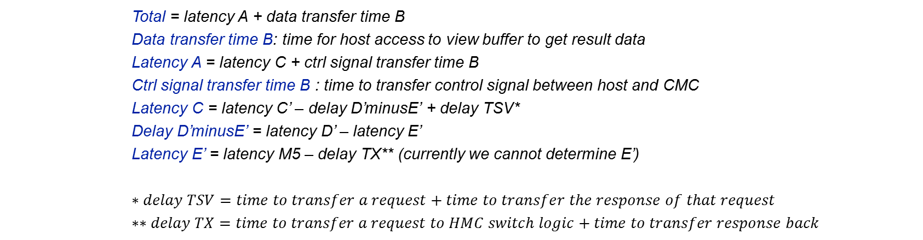


Model of CMC-to-Merlin Mapping
Model of notional CMC
CMC platform on Merlin board
**
$$TX$$
M3 M4 M5
E’
$$delay D^{′}minusE^{′}$$
Total = latency A + data transfer time B
Data transfer time B: time for host access to view buffer to get result data
Latency A = latency C + ctrl signal transfer time B
Ctrl signal transfer time B : time to transfer control signal between host and CMC
Latency C = latency C’ – delay D’minusE’ + delay TSV*
Delay D’minusE’ = latency D’ – latency E’
Latency E’ = latency M5 – delay TX** (currently we cannot determine E’)
$$∗delay TSV=time to transfer a request+time to transfer the response of that request$$
$$∗∗delay TX=time to transfer a request to HMC switch logic+time to transfer response back$$
Latency: round-trip delay from input into a point in the system to desired outcome

Slide 9
Outline
Review & overview
Notional CMC architecture
Performance measurements on Merlin board
Mapping notional CMC to Merlin board
Experiments & measurements
Non-overlapping memory access
Simple read & write ops, DRE ops
Overlapping memory access
Simple read & write ops, DRE ops
Simplified CMC-to-Merlin mapping
Performance mapping of DRE operations
Case study result of random access app.
Going forward
* DRE: Data rearrangement/reordering engine ** CMC Computational Memory Cube

Slide 10
Review of DRE setup, fill, drain
void setup(value_pointer refp, index_pointer indexp, value_pointer sp)
{
ref_base = refp;
idx_base = indexp;
scratchpad = sp;
}
void fill() {
for (size_t i = 0; i < scratchpad.length(); i++) {
scratchpad[i] = ref_base[idx_base[i]];
}
}
void drain() {
for (size_t i = 0; i < scratchpad.length(); i++) {
ref_base[idx_base[i]] = scratchpad[i];
}
}

Slide 11
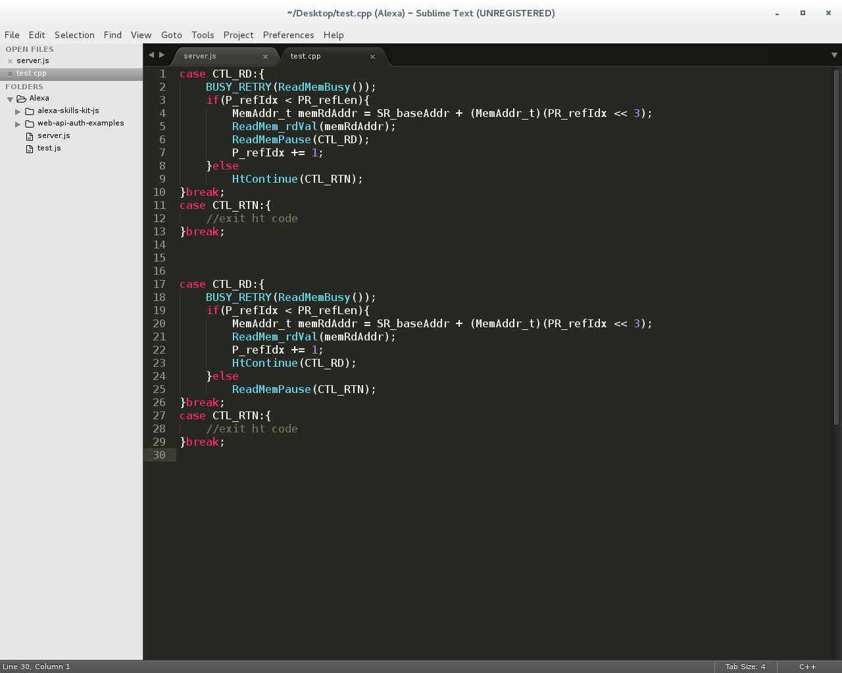
Memory Access on Merlin Board
Non-overlapping memory access
Overlapping memory access
Wait for data return before issuing next memory request
Send next memory request immediately after sending previous one
Barrier synchronization to guarantee all responses are returned before exiting code

Slide 12
Non-overlapping Memory Access
Consistent with expectation: M1 > M2 > M3 (> M4 > M5 > E’)
Measured performance: simple read/write (µs) (Averaged over 100,000 iterations)
Oper. | A’ (µs) | C’ | D’ | M1 | M2 | M3
Read | 1095.6 | 1.03 | 1.006 | 0.923 | 0.725 | 0.519
Write | 1104.0 | 1.071 | 1.011 | 0.991 | 0.793 | 0.577
Measured performance: Vector Addition in ms (100,000 iterations of 2 reads & 1 write)
A’ (ms) | C’ | D’ | M1 | M2 | M3
282.55 | 281.72 | 278.72 | 258.96 | 199.68 | 151.31
Measured performance: SpMV – DRE app in seconds (2²⁴ X 2²⁴ matrix)
A’ (s) | C’ | D’ | M1 | M2 | M3
1658.67 | 1580.14 | 1559.65 | 1460.57 | 1122.42 | 839.84

Slide 13
Overlapping Memory Access: read/write ops
Observation: M1, M2, M3, (M4, M5, E’) have no significant difference

Slide 14
Overlapping Memory Access: DRE ops
M1, M2, M3, (M4, M5, E’) have no significant difference
For overlapping memory access, discrepancy between M1, M2, M3, M4, M5, E’ is hidden by pipeline

Slide 15
Outline
Review & overview
Notional CMC architecture
Performance measurements on Merlin board
Mapping notional CMC to Merlin board
Experiments & measurements
Non-overlapping memory access
Simple read & write ops, DRE ops
Overlapping memory access
Simple read & write ops, DRE ops
Simplified CMC-to-Merlin mapping
Performance mapping of DRE operations
Case study result of random access app.
Going forward
* DRE: Data rearrangement/reordering engine ** CMC Computational Memory Cube

Slide 16
Simplified Notional CMC Modeling
For pipelined overlapping memory operations, estimate:
M1 = M2 = M3 = M4 = M5 = E’
Model of notional CMC
CMC platform on Merlin board
**
$$TX$$
M3 M4 M5
E’
$$delay D^{′}minusE^{′}$$
Total = latency A + data transfer time B
Data transfer time B: time for host access to view buffer to get result data
Latency A = latency C +ctrl signal transfer time B
Ctrl signal transfer time B : time to transfer control signal between host and CMC
Latency C = latency C’ – delay D’minusE’ + delay TSV*
Delay D’minusE’ = latency D’ – latency E’
Latency E’ = latency M5 – delay TX** (currently we cannot determine E’)
Latency: round-trip delay from input into a point in the system to desired outcome

Slide 17
Simplified Notional CMC Modeling
For pipelined overlapping memory operations, estimate:
M1 = M2 = M3 = M4 = M5 = E’
Model of notional CMC
CMC platform on Merlin board
**
$$TX$$
M3 M4 M5
E’
$$delay D^{′}minusE^{′}$$
Total = latency A + data transfer time B
Data transfer time B: time for host access to view buffer to get result data
Latency A = latency C +ctrl signal transfer time B
Ctrl signal transfer time B : time to transfer control signal between host and CMC
Latency C = latency C’ + delay TSV*
* delay TSV = time to transfer request + time to transfer response
Latency: round-trip delay from input into a point in the system to desired outcome

Slide 18
Outline
Review & overview
Notional CMC architecture
Performance measurements on Merlin board
Mapping notional CMC to Merlin board
Experiments & measurements
Non-overlapping memory access
Simple read & write ops, DRE ops
Overlapping memory access
Simple read & write ops, DRE ops
Simplified CMC-to-Merlin mapping
Application of simplified mapping to DRE design option 3
Going forward
* DRE: Data rearrangement/reordering engine ** CMC Computational Memory Cube

Slide 19
Scope and Parameter Definition
Current scope: 1 link, 1 CMC core architecture
Scale and parameterized in the future (n links, m core)
CMC Core
link
Link parameters:
BW_{link}: Bandwidth of host-CMC interface (bit/s)
W_{host-cmc}: Bit width of host-CMC message (request + response) (bit)
Data: W_{host-cmc}(data) Ctrl: W_{host-cmc}(ctrl)
TSV parameters
BW_{TSV}: Bandwidth of TSV connection (bit/s)
W_{core-vc}: Bit width of core-vault message (request + response) (bit)

Slide 20
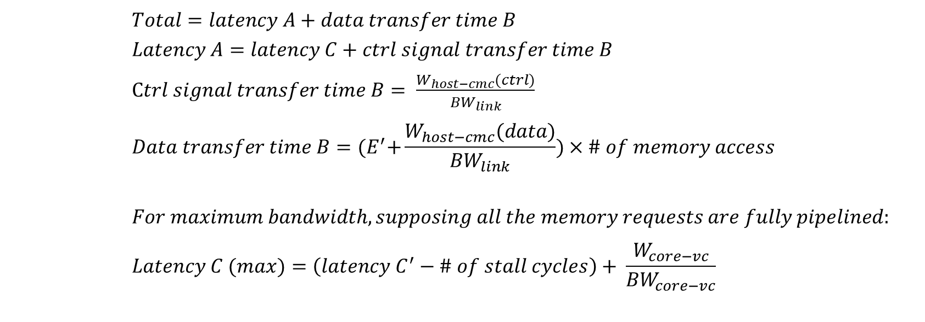
Best-case Performance (Design Op3, 1 link, 1 CMC core)
Model of notional CMC
CMC platform on Merlin board
**
M3 M4 M5
$$TX$$
E’
$$delay D^{′}minusE^{′}$$
$$Total=latency A+data transfer time B$$
$$Latency A=latency C+ctrl signal transfer time B$$
$Ctrl signal transfer time B= \frac{W_{host−cmc}(ctrl)}{{BW}_{link}}$
$$Data transfer time B={(E}^{′}+\frac{W_{host−cmc}(data)}{{BW}_{link}})×\# of memory access$$
$$For maximum bandwidth, supposing all the memory requests are fully pipelined:$$
$$Latency C (max)=\left(latency C^{′}−\# of stall cycles\right)+ \frac{W_{core−vc}}{{BW}_{core−vc}}$$

Slide 21
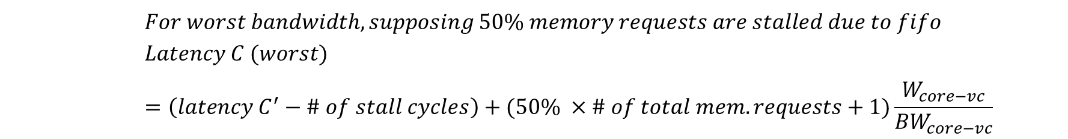
Worst-case performance (Design Op3, 1 link, 1 CMC core)
Model of notional CMC
CMC platform on Merlin board
**
M3 M4 M5
$$TX$$
E’
$$delay D^{′}minusE^{′}$$
$$For worst bandwidth, supposing 50\% memory requests are stalled due to fifo$$
$$Latency C (worst)=\left(latency C^{′}−\# of stall cycles\right)+(50\% ×\# of total mem. requests+1)\frac{W_{core−vc}}{{BW}_{core−vc}}$$

Slide 22
Case Study Result for Random Access App.

Slide 23
Going Forward
Creating user-friendly CMC API
Share code and lessons with LPS
Visit LPS at some time
Continue researching on CMC modelling for multiple links multiple CMC cores
Study sorting and bloom filter on CMC

